Slide 1


NeedleBench: Can LLMs Do Retrieval and Reasoning in Information-Dense Context?
Lukas Czurgel

Slide 2

Overview
Table of Contents:
Motivation and Background
What is a context window?
Why we care about long context retrieval
Evaluating long context retrieval
Related Work
NIHA
RULER
LongBench
NeedleBench
Methodology
Evaluation
Results
Conclusion

Slide 3
Motivation & Background

Slide 4
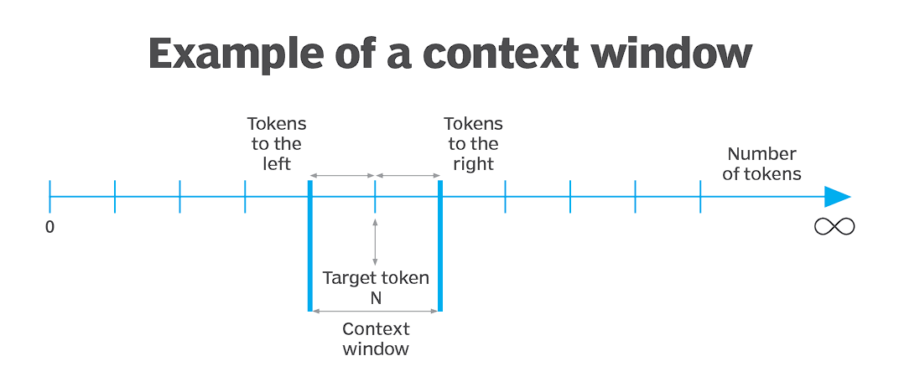
Background – What is a context window?
Working memory or RAM of models with transformer architecture
Contains the prompt, system prompt, conversation history and any additional documents relevant for the task at hand
We often use pre-selection techniques like RAG to maximize the relevant tokens in the context window

Slide 5
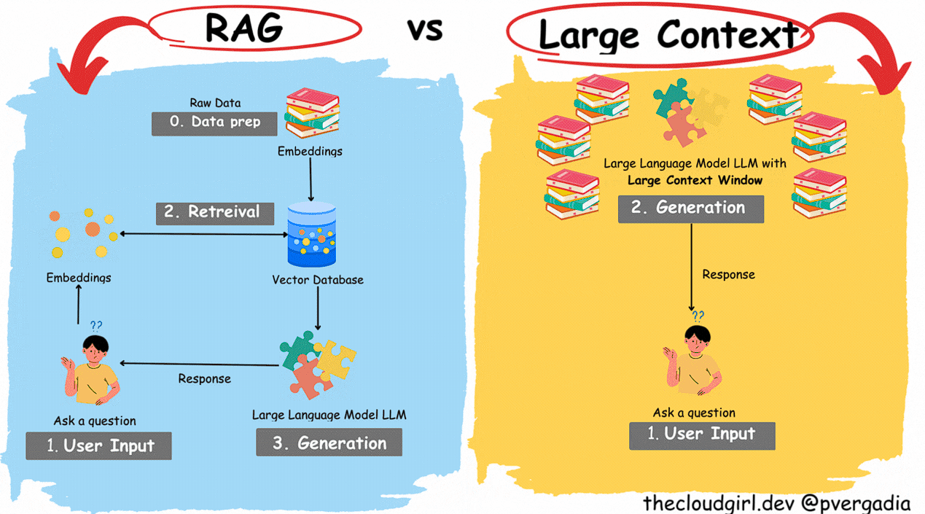
Motivation – Why long context retrieval?
Longer prompts and outputs
RAG: More content can be included
Conversational Applications: Conversations can be longer before the model ‘forgets’ previous exchanges
Potentially replace RAG with ultra long context models: Cache Augmented Generation (CAG)

Slide 6
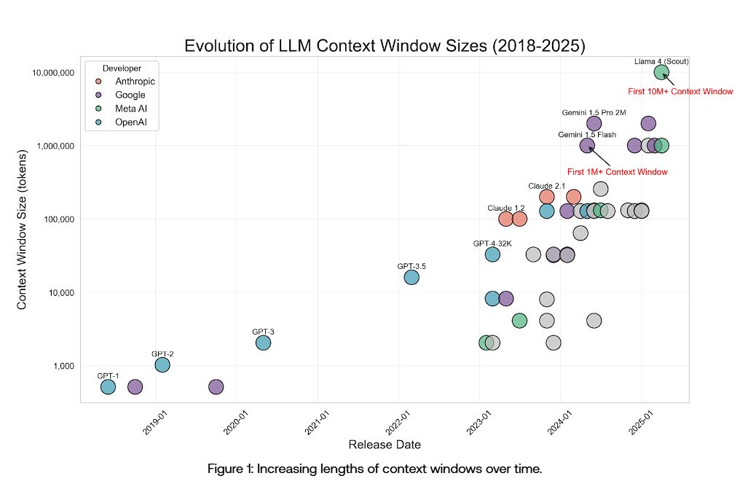
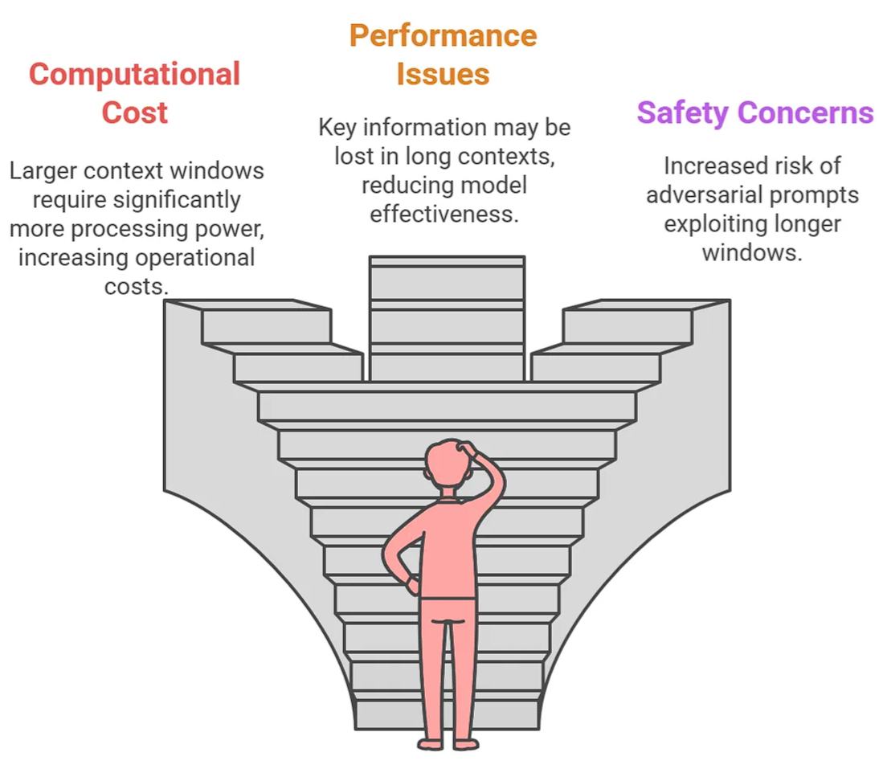
Evaluating long context retrieval
Question: How do we evaluate long context LLMs?
Answer: We search for the needle in the Haystack!

Slide 7
Related Works

Slide 8
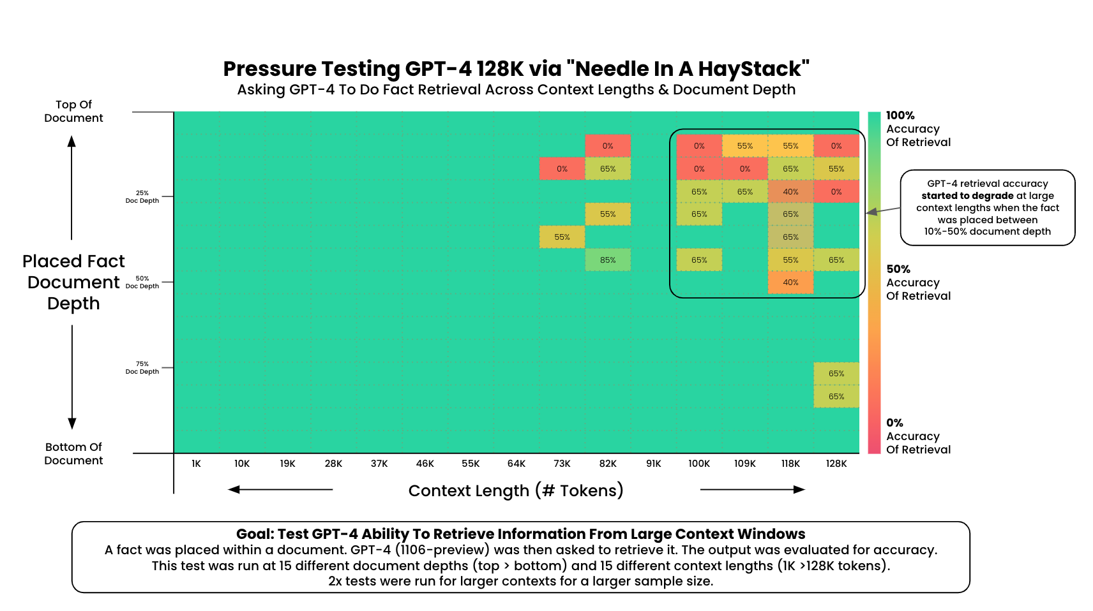
NIAH Benchmarks
Origin of the NIAH Test:
LLMTest NeedleInAHaystack: The Initial test developed by Developed by Greg Kamradt
NIAH Benchmark Frameworks:
RULER (Hsieh et al.)
LongBench (Bai et al.)

Slide 9
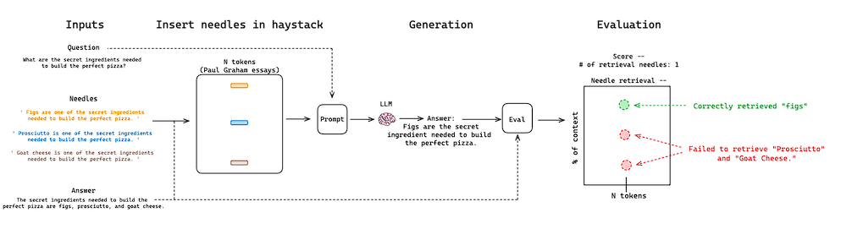
Related Work – Needle in a Haystack (G. Kamradt 2023)
Limitations:
Needles are irrelevant filler content and require no reasoning ability
Modern LLMs crush the basic NIAH test

Slide 10
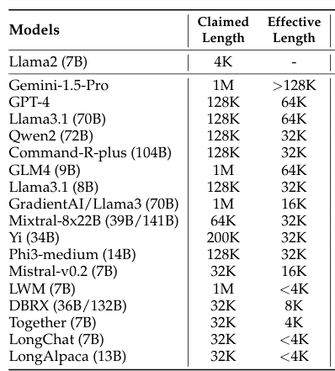
Related Work - RULER (Hsieh et al. 2024)
Setup:
Bilingual (English / Chinese) Synthetic Tests from 4K to 128K tokens
Focus:
Evaluation on retrieval, multi-hop tracing, aggregation, and question answering.
Findings:
Near perfect performance for base NIAH, but failure to maintain results with increased input size.
Limitations:
Synthetic stacks may make it easier to find the needle
Low correlation with real-world applications

Slide 11
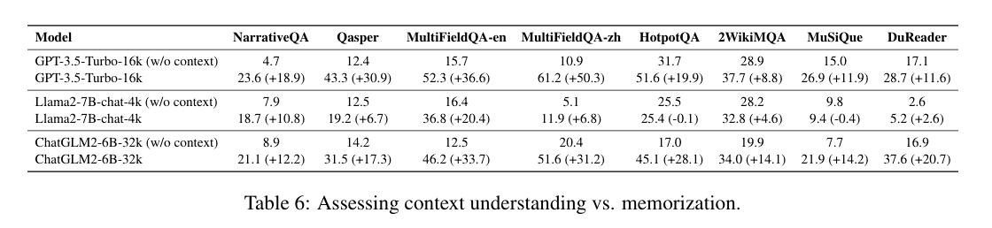
Related Work – Longbench (Bai et al. 2024)
Setup:
Bilingual (English / Chinese) real text tests of ~4-32K tokens
Focus:
Diverse comprehension tasks: QA, Summarization, code-completion, Few-shot learning
Findings:
Open-source models still lag behind closed-source in longer context tasks.
Limitations:
Instruction-following ability of the model influences test results
Real world application tests may be solved by parameterized knowledge instead of retrieval
Non-synthetic data is less controllable / flexible

Slide 12
The Needlebench Framework

Slide 13
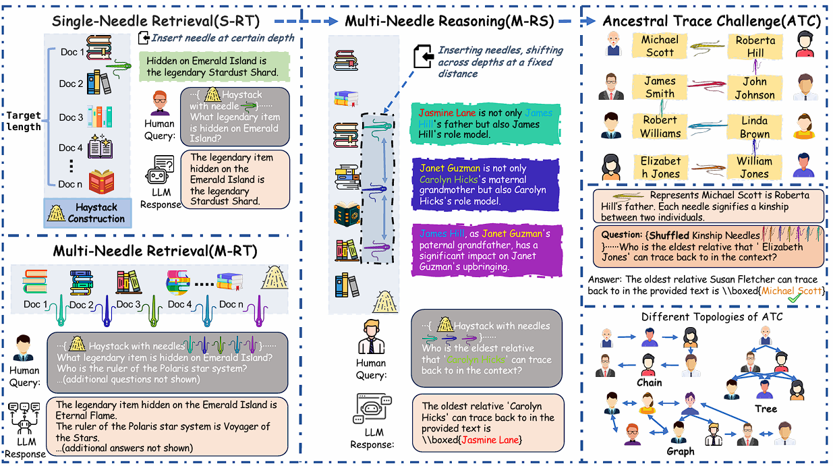
NeedleBench (Mo Li et al. )
Goals:
Adaptability and scalability beyond 1000k tokens
Minimize reliance of irrelevant filler
Synthetic dataset to minimize the impact of parameterized knowledge
Assess reasoning ability in long context scenarios
Two types of tests:
Information-sparse
Information-dense

Slide 14
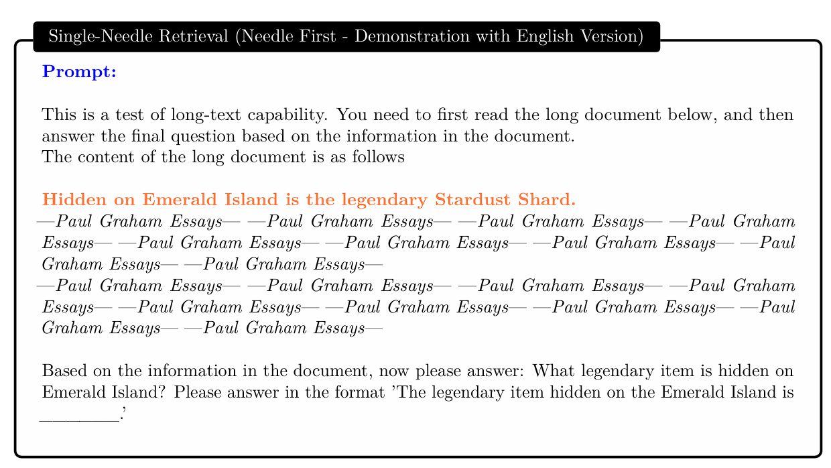
Information-Sparse Tasks
Information-Sparse:
Characterized by minimal relevant details embedded within extensive irrelevant text to simulate simpler real-world retrieval tasks
Three types of tests:
Single-Needle Retrieval Task (S-RT)
Multi-Needle Retrieval Task (M-RT)
Multi-Needle Reasoning Task (M-RS)

Slide 15
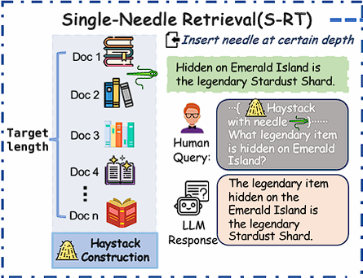
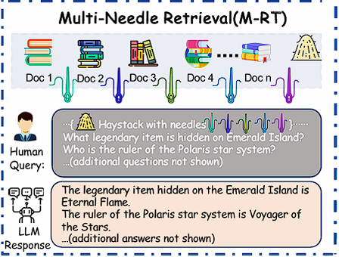
Single-Needle Retrieval Task (S-RT):
Tests LLMs’ ability to recall a single key information (needle)
Needle: synthetic, abstract, and fictional statements or relational facts
Most basic application of a NIHA
Multi-Needle Retrieval Task (M-RT)
Expands S-RT to multiple needles
simulating complex real-world queries that require extracting several data points
Needles are still independent

Slide 16
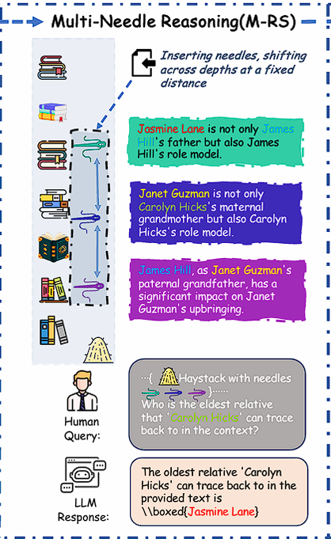
Multi-Needle Reasoning Task (M-RS)
Expands on M-RT by requiring reasoning across multiple datapoints
Each needle provides a piece of the puzzle
Finding each needle may be required to answer the query

Slide 17
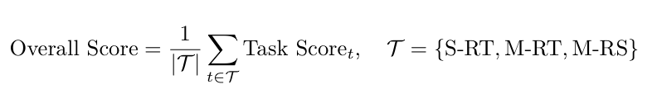
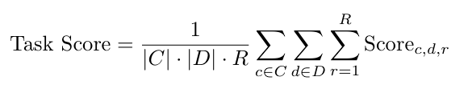
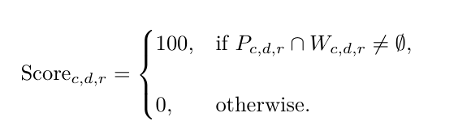
Information-Sparse Tasks: Evaluation
Exact Match:
Full credit is awarded if any keyword from Wc,d,r appears in Pc,d,r, and zero otherwise
C represents the set of context lengths
D represents the set of needle depths or positions
R represents the number of repetitions for each configuration.
The test was repeated R=10 times for each configuration

Slide 18
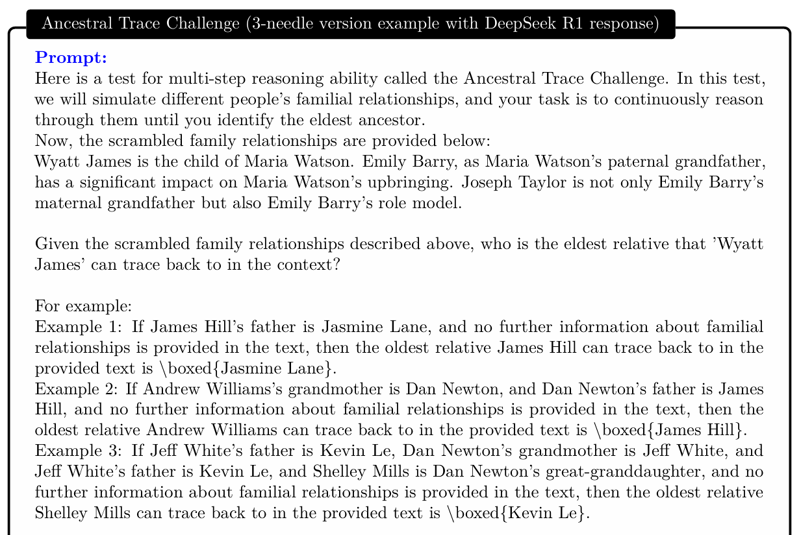
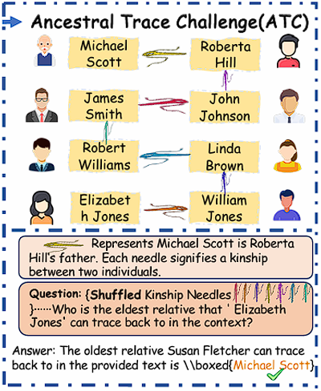
Information-Dense Tasks

Slide 19
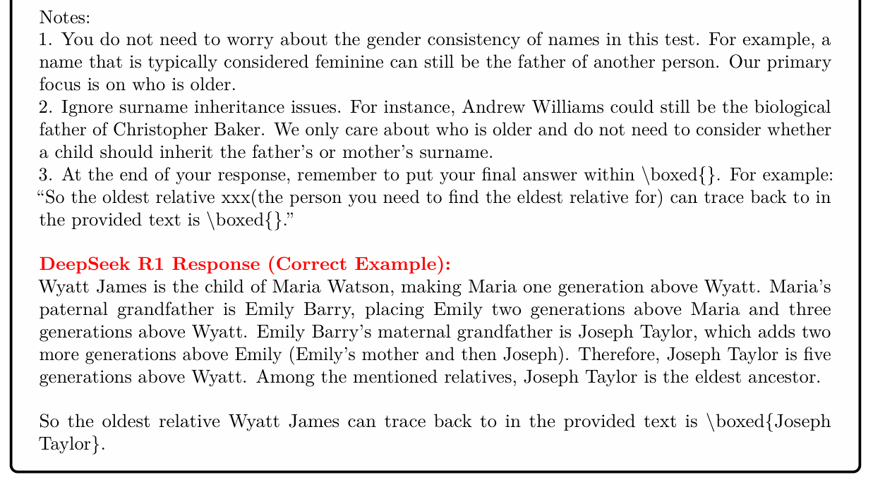
Information-Dense Tasks
Diversity of ATC Tasks:
Randomized names
Tasks model various family dynamics
Relationship distance, n-th eldest ancestor etc.
Varied needle count and context length

Slide 20
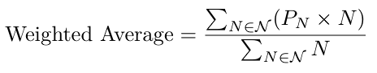
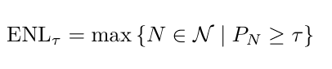
Information-Dense Tasks: Evaluation
Weighted exact match metric
Weights are proportional to task difficulty (needle count)
Measured across different difficulty levels
ENL τ : the maximum task difficulty at which the model can still achieve at least τ % accuracy
The test was repeated R=10 times for each configuration, τ = 50.

Slide 21
Experiments

Slide 22
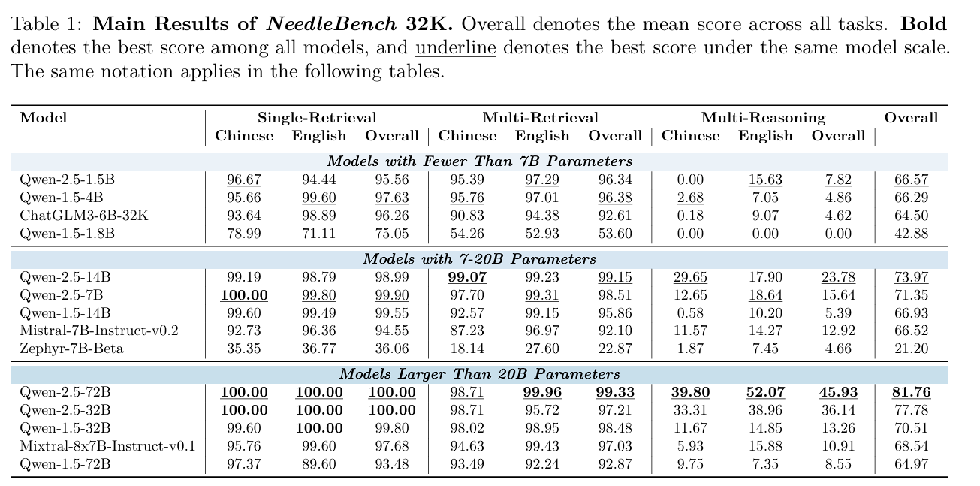
Information-Sparse Tasks: Results
Evaluation of several Parameters:
Impact of Model Architecture and Generation
Effect of Model Scale on Multi-Needle Reasoning Performance
Effect of Needle Count on Multi-Needle Reasoning Performance
Impact of Language

Slide 23
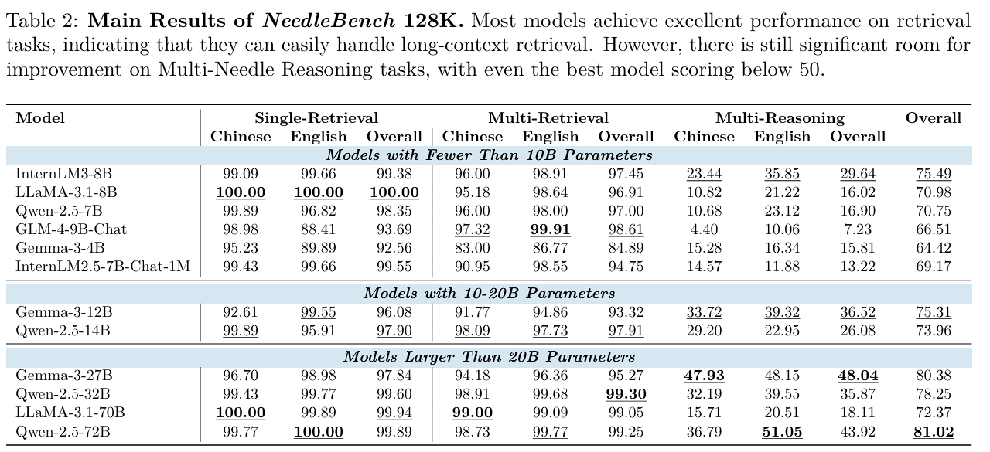
Information-Sparse Tasks: Results
Overall Results:
Evaluation of mainstream open source LLMs at context lengths of 32K and 128K
As in RULER, modern LLMs achieve almost perfect scores in S-RT and M-RT tasks.
Significant dip in performance in reasoning tasks: Qwen-2.5 performs best at < 50

Slide 24
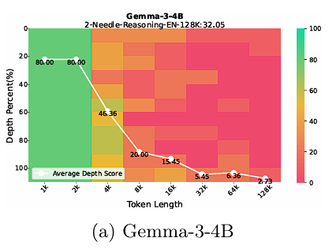
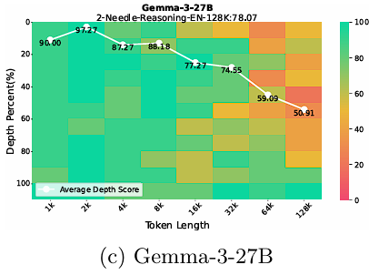
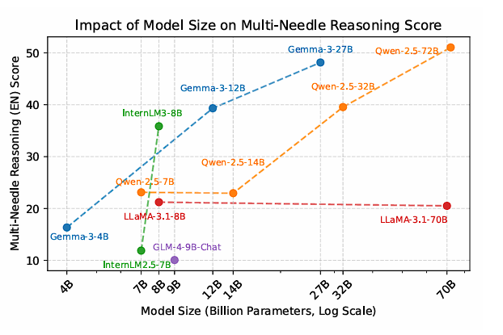
Model Scale, Needle Count and Language in M-RS
General positive correlation between model size and reasoning ability in M-RS
Not universally applicable: LLaMA-3.1 only marginally improves from 8 to 70B
Some small models overperform, suggesting model architecture to be a factor: IntermLM
Performance degrades with increased needle count
Generally: English language performance trumps Chinese. Outlier: Qwen-2.5

Slide 25
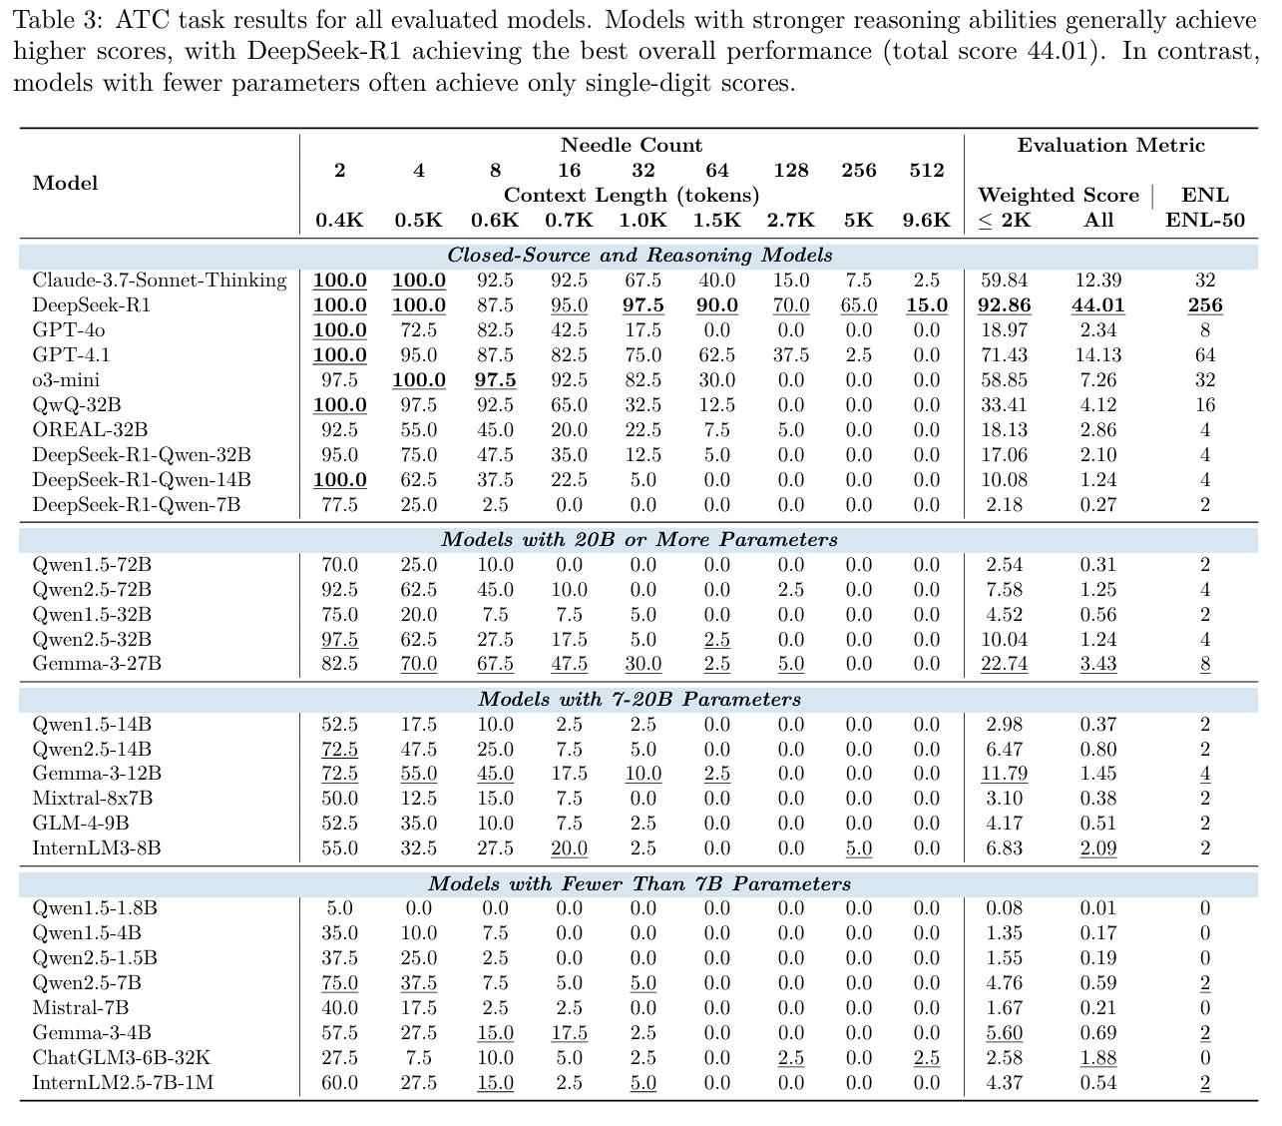
Information-Dense Tasks: Results
Overall Results:
Performance strongly decreases with increased task complexity (needle count)
Complete failure beyond 64-needles
Increased model size seems to have a positive impact on performance
Model architecture seems to play a significant role – Gemma series performs well across all model sizes

Slide 26
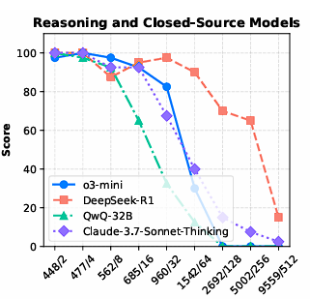
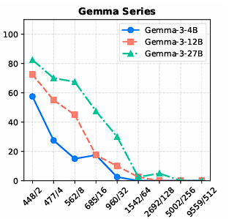
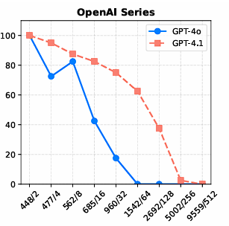
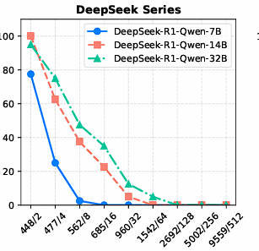
Results - Breakdown
DeepSeek-R1-Qwen destilation performance is surprisingly poor compared to DeepSeek
GPT-4 series and DeepSeek show less significant decline with increased needle count
Gemma Series performs well for small scale ATC (4B,12B,and27B)

Slide 27
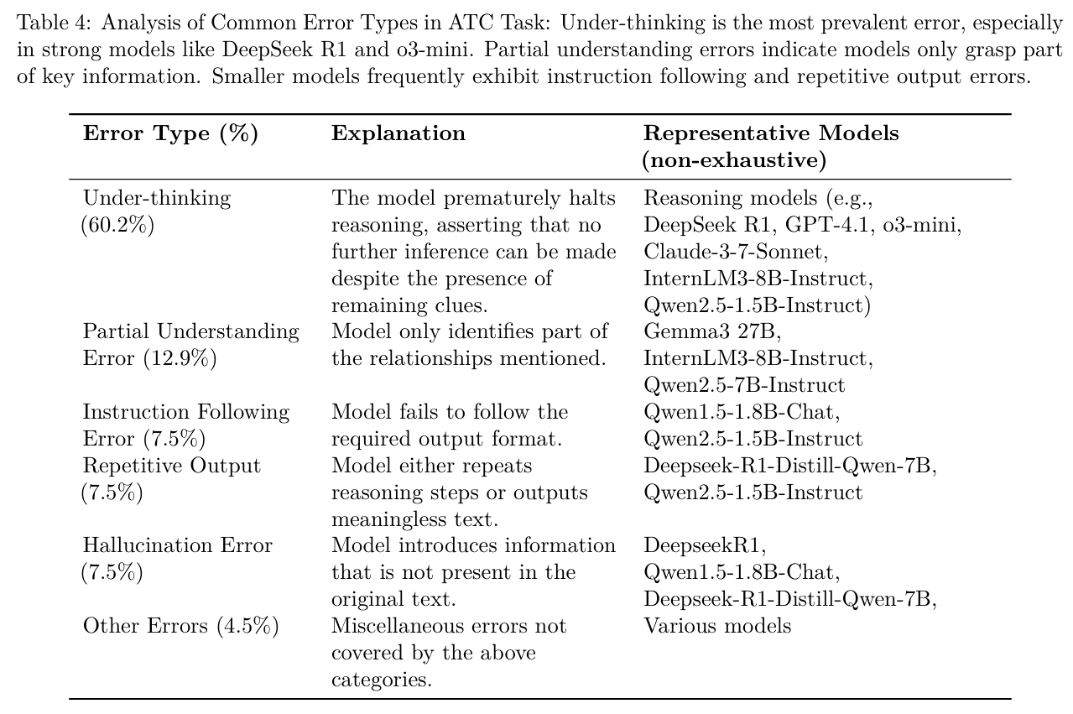
Results – Reasoning Errors
Manual annotation of 10% of ATC errors
“Under-Thinking” as primary error type
Other types more common in smaller scale models
“Under-Thinking”: Models prematurely conclude that no further inference can be made, even when clear clues remain in the context.

Slide 28
NeedleBench Summary
Findings:
Framework for NIHA testing focused on reasoning ability.
Highlights weakpoints in information-dense, multi-step retrieval and reasoning in long context tasks.
Premature conclusion (“Under-Thinking”) as major weakness of current models.
Limitations:
Tests are still synthetic and may not mirror real world applications.
Heavy focus on Ancestral Trace Challenge

Slide 29
Images and References
Needle in Haystack by Browserling on Dribbble
What is a context window?
🧠Understanding LLM Context Windows: Tokens, Attention, and Challenges | by Tahir | Medium
Multi Needle in a Haystack
RagvsLargeContext.gif (1280×720)
image-4.png (1000×281)
Understanding the Impact of Increasing LLM Context Windows - Meibel

Slide 30
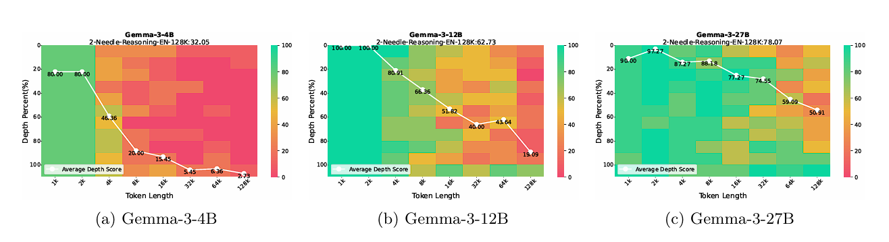
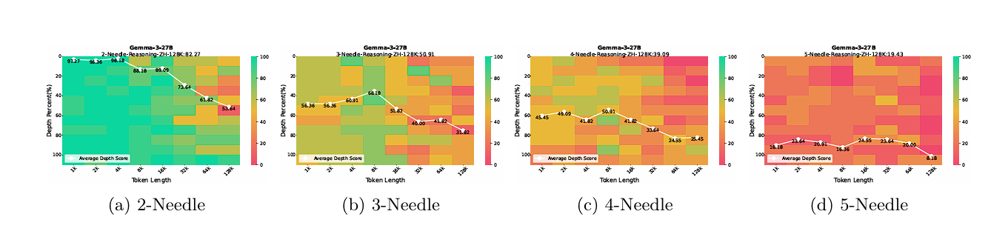
Performance – Generation and Needle Count

Slide 31
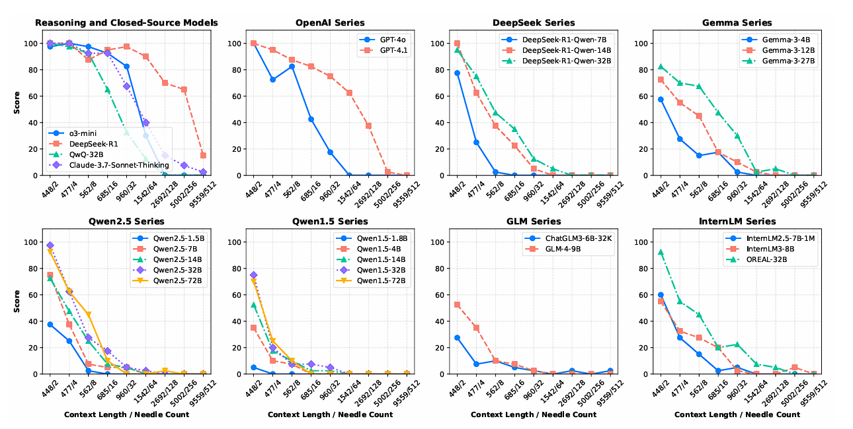
Results - Breakdown

Slide 32
The needle in a haystack Test (NIHA)
Place a fact or statement (the needle) inside a chunk of a body of unrelated text (the haystack)
01
Provide the LLM with this text and a prompt asking about the needle
02
Iterate over various document depths (where the needle is placed) and context lengths to measure performance
03
Aggregate the results and evaluate accuracy
04

Slide 33
- Need for large corpora to evaluate large context sizes, these may be synthetic

Slide 34
Related Work - Longbench
RULER (Hsieh et al.): shows that passing retrieval tests does not always mean robust understanding. Models can focus on certain key points to find the needle.
LongBench(Bai et al.): more realistic tests run the risk of allowing the model to rely on its general knowledge to answer the test questions even without finding the needle

Slide 35
NeedleBench: Can LLMs Do Retrieval and Reasoning in Information-Dense Context?
Published by Mo Li et al. in https://arxiv.org/abs/2407.11963
Aims to provide a more sophisticated Benchmarking framework

Slide 36
Needle bench – Methodology
assess retrieval and reasoning performance in bilingual long-context tasks
context lengths of (e.g., 32k, 128k, and beyond)
Two types of tests
information-sparse, characterized by minimal relevant details embedded within extensive irrelevant text to simulate simpler real-world retrieval tasks;
information-dense, implemented as the Ancestral Trace Challenge, where relevant information is continuously distributed throughout the context to simulate more complex real-world reasoning tasks.

Slide 37
Single-Needle Retrieval Task (S-RT)
Tests LLMs’ ability to recall a single key information (needle)
Needle: synthetic, abstract, and fictional statements or relational facts
Most basic application of a NIHA

Slide 38
Multi-Needle Retrieval Task (M-RT)
Expands S-RT to multiple needles
simulating complex real-world queries that require extracting several data points
Needles are still independent

Slide 39
Information-Sparse Tasks: Evaluation
c: represents the context length
d: represents the needle depth or position
r: represents the index of repetition.
Exact Match:
Full credit is awarded if any keyword from Wc,d,r appears in Pc,d,r, and zero otherwise

Slide 40
Information-Sparse Tasks: Evaluation
C represents the set of context lengths
D represents the set of needle depths or positions
R represents the number of repetitions for each configuration.
The test was repeated R=10 times for each configuration

